Slide 1
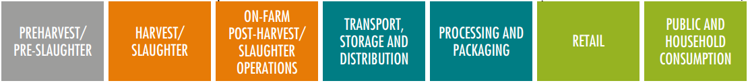
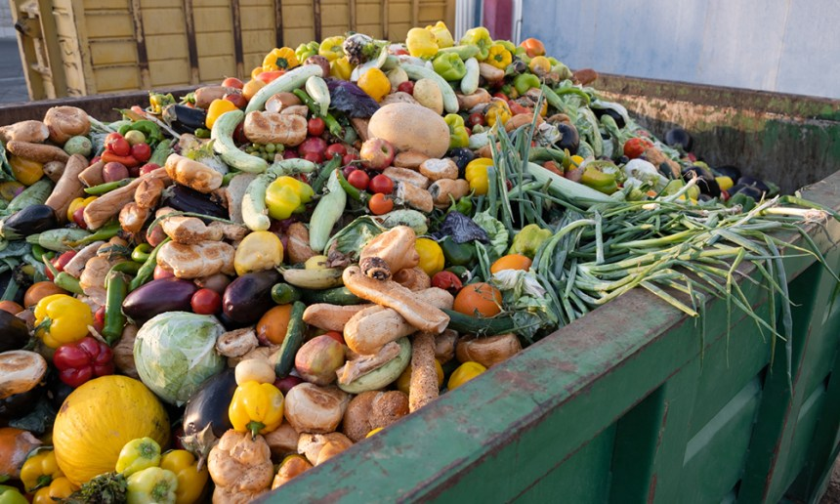
FL quantification
What is Food Loss (and Waste)?
EU has no split up into Food Loss and Food Waste; only Food Waste
SDG 12.3 and FAO use split up which is related to part of the supply chain
INTRODUCTION
Focus in this document
Food Loss
Food Waste
EU part of supply chain involved – food waste

Slide 2
Food Loss (and Waste)
FL quantification
INTRODUCTION
  is on the agenda in NL, EU (legal targets are coming!) and worldwide
  can be complex to quantify
  quantification is necessary to act effectively (hot spots)
  quantification provides insight in ROI with respect to reduction measures (business case)
This tool is based on the WRI FLW protocol and created to accommodate stakeholders to quantify food loss in the context that is described above

Slide 3
Legend
FL quantification
please click on arrow to go to next slide
(this arrow is there only if we want you not to skip relevant info)
this can be used to go to previous (whatever number) slide
(only 1 back)
end of subtopic (in most cases you select another block at the top
or on the side)
click to go to reference list
click to go to abbreviations
B
E
R
A

Slide 4
What steps to take?
Step 1:
Define goals
Step 2:
Make the goal(s) SMART
Step 3:
Type of information needed
Step 1: Define goals
Step 2: Make the goal(s) SMART
Step 3: What type of information do I need?
Step 4: Select quantification method
Step 5: Upscaling considerations
Background: Reference list
Step 4:
Select quantification method
Step 5:
Upscaling considerations
Background:
Reference list
A

Slide 5
Step 1: Define goal(s)
Step 1:
Define goals
Step 2:
Make the goal(s) SMART
Step 3:
Type of information needed
  Context:
  various entities (EU, UN, countries) set goals with respect to FLW reduction
  some are/will be legally binding, most of them not
  these goals are high level (world, continent, country)
  Non-governmental stakeholders can comply with these goals, but don’t have to (yet); they can make their own targets
Step 4:
Select quantification method
Step 5:
Upscaling considerations
Background:
Reference list
A
B

Slide 6



Step 1: Define goal(s)
Step 1:
Define goals
Step 2:
Make the goal(s) SMART
Step 3:
Type of information needed
Comply with external goal(s)
Set your own goal(s)
Step 4:
Select quantification method
Step 5:
Upscaling considerations
EU regulation
Own goal(s)
SDG 12.3
NL government
Background:
Reference list
A
B

Slide 7
External: EU regulation
Step 1:
Define goals
EU regulation
SDG 12.3
NL government
Own goal(s)
Introduction
Goal
Step 2:
Make the goal(s) SMART
Step 3:
Type of information needed
The Commission is proposing to set legally binding food waste reduction
targets to be achieved by Member States by 2030, as part of the revision
of the Waste Framework Directive, adopted by the Commission on 5 July 2023.
The results of the first EU-wide monitoring of food waste levels carried out
in 2020 will serve as a baseline to assess progress towards the targets.
Step 4:
Select quantification method
Step 5:
Upscaling considerations
Background:
Reference list
A
B

Slide 8
EU - Goal
Step 1:
Define goals
EU regulation
SDG 12.3
NL government
Own goal(s)
Introduction
Goal
Step 2:
Make the goal(s) SMART
Step 3:
Type of information needed
Current proposal (to be formalized)
Member States (region) are required to take the necessary measures to reduce food waste by the end of 2030:
  by 10%, in processing and manufacturing (tons of fresh mass),
  by 30% (per capita), jointly at retail and consumption (restaurants, food services (=out of home) and households).
Reference year is 2020 (or earlier, when data are available)
Step 4:
Select quantification method
Step 5:
Upscaling considerations
Background:
Reference list
E
A
B

Slide 9
External: SDG 12.3
Step 1:
Define goals
EU regulation
SDG 12.3
NL government
Own goal(s)
Introduction
Goal
Step 2:
Make the goal(s) SMART
Step 3:
Type of information needed
  In September 2015 at the United Nations General Assembly, countries of the world formally adopted a set of 17 Sustainable Development Goals (SDGs).
  SDG 12.3 is about Food Loss and Waste
Step 4:
Select quantification method
Step 5:
Upscaling considerations
Background:
Reference list
A
B

Slide 10
SDG 12.3 - Goal
Step 1:
Define goals
EU regulation
SDG 12.3
NL government
Own goal(s)
Introduction
Goal
Step 2:
Make the goal(s) SMART
Step 3:
Type of information needed
By 2030, halve per capita global food waste at the retail and consumer levels and reduce food losses along production and supply chains, including post-harvest losses (hence no quantitative targets for food loss). Reference year is 2015.
Step 4:
Select quantification method
Step 5:
Upscaling considerations
Background:
Reference list
E
A
B

Slide 11
External: NL government
Step 1:
Define goals
EU regulation
SDG 12.3
NL government
Own goal(s)
Introduction
Goal
Step 2:
Make the goal(s) SMART
Step 3:
Type of information needed
  The Netherlands (as the EU) is committed to expanding the SDG 12.3 goal, which applies from distribution to consumer, to a 50% reduction in the entire
  food chain.
  There is no formalization yet within the EU nor in the Netherlands
Step 4:
Select quantification method
Step 5:
Upscaling considerations
Background:
Reference list
A
B

Slide 12
NL government – Goal
Step 1:
Define goals
EU regulation
SDG 12.3
NL government
Own goal(s)
Introduction
Goal
Step 2:
Make the goal(s) SMART
Step 3:
Type of information needed
The Dutch government, together with the other EU member states, has committed to the UN SDG Goal 12.3: reduce food waste at consumers and retail by 50% by 2030 compared to 2015 and reducing food waste in the rest of the chain.
The Dutch government has to comply with EU legal targets when they become official (see EU regulation – Goal)
Conversion of Dutch policy to stakeholders not discussed yet (implication
for companies (if any) unclear)
Step 4:
Select quantification method
Step 5:
Upscaling considerations
Background:
Reference list
E
A
B

Slide 13
Choose your own goal(s)
Step 1:
Define goals
EU regulation
SDG 12.3
NL government
Own goal(s)
Step 2:
Make the goal(s) SMART
Step 3:
Type of information needed
Examples: want to
  reduce FL value with 10% next year
  know if packaging investment is feasible in relation to food loss savings (ROI)
  monitor to find hot spots and reduce food loss there
  be at least at the same level as competitors with respect to food loss
Step 4:
Select quantification method
Step 5:
Upscaling considerations
Background:
Reference list
E
A
B

Slide 14
Step 2: Make the goal(s) SMART
Step 1:
Define goals
Step 2:
Make the goal(s) SMART
Step 3:
Type of information needed
Before you can start the quantification of your loss, you need to be very specific (SMART) about what you want with respect to several choices (scope). Moreover, the context is relevant, since definitions of FLW may vary in the different regions.
This document supports you in this complex process.
Step 4:
Select quantification method
Step 5:
Upscaling considerations
Background:
Reference list
A
B

Slide 15
Step 2: Make the goal(s) SMART
Step 1:
Define goals
Step 2:
Make the goal(s) SMART
Step 3:
Type of information needed
Step 4:
Select quantification method
Focus
Step 5:
Upscaling considerations
The combination leads
to the indicators to quantify
Quantification unit
Definition FL
Background:
Reference list
A
B

Slide 16
Step 2: Make the goal(s) SMART
Step 1:
Define goals
Scope a: Focus
Scope b: Quantification unit
Scope c: Definition FL(W)
Step 2:
Make the goal(s) SMART
Step 3:
Type of information needed
Make a choice with respect to
Focus: What product, what geographic area, which part of the supply chain, and for what time period do you want to quantify?
Quantification unit(s): weight, value, % of input , …
Definition FL(W): there are various definitions for FL(W), and maybe you
want to make one yourself
Step 4:
Select quantification method
Step 5:
Upscaling considerations
Background:
Reference list
A
B

Slide 17
Step 2a) Focus select one per item
Step 1:
Define goals
Scope a: Focus
Scope b: Quantification unit
Scope c: Definition FL(W)
Step 2:
Make the goal(s) SMART
Step 3:
Type of information needed
  Product: (food total, food category, food product(s), variety of food product)
  Boundary: region (continent, country, province, company location(s),…)
  Supply Chain Link: Sector, supply chain link(s), activity within supply chain link (e.g. storage at farm level)
  Time: want to quantify FL per year, season, week, for 2023
Step 4:
Select quantification method
Step 5:
Upscaling considerations
Background:
Reference list
A
B

Slide 18
Examples own choices Step 2a) Focus
Step 1:
Define goals
Scope a: Focus
Scope b: Quantification unit
Scope c: Definition FL(W)
Step 2:
Make the goal(s) SMART
Step 3:
Type of information needed
Example 1: farmer Janssen wants to quantify the food loss of his strawberries
in the summer season of 2023
Step 4:
Select quantification method
Step 5:
Upscaling considerations
dimension | Example 1 | Example 2 | Example 3
Product | Strawberry | Sea fish | Fruit & vegetables
Boundary | Farm location | IJmuiden | NL
SCL | Farm Janssen | Fish market | Wholesale sector
Time | Summer 2023 | 2023 | 2023
Background:
Reference list
A
B

Slide 19
Remark
Step 1:
Define goals
Scope a: Focus
Scope b: Quantification unit
Scope c: Definition FL(W)
Step 2:
Make the goal(s) SMART
Step 3:
Type of information needed
  Note that for every choice in the focus (product, SCL, etc.) more selections can be made, e.g., for you want to quantify FL for mango and banana.
  In that case, the quantification of FL will be treated separately per product. It is then very likely that there is overlap between the approaches when this protocol is applied.
  The user can combine wherever appropriate.
  This holds for all focus items with more than 1 selection.
Step 4:
Select quantification method
Step 5:
Upscaling considerations
Background:
Reference list
E
A
B

Slide 20
Step 2b) Decide on the quantification unit
Step 1:
Define goals
Scope a: Focus
Scope b: Quantification unit
Scope c: Definition FL(W)
Step 2:
Make the goal(s) SMART
Step 3:
Type of information needed
In FLW quantification practice, there are three major quantification units:
Weight (kg, tons, Mtons, …)
% of production/inputs
Value (money)
Step 4:
Select quantification method
Step 5:
Upscaling considerations
Background:
Reference list
A
B

Slide 21
Step 2b) Decide on the quantification unit
Step 1:
Define goals
Scope a: Focus
Scope b: Quantification unit
Scope c: Definition FL(W)
Step 2:
Make the goal(s) SMART
Step 3:
Type of information needed
Other examples of quantification units are:
  Food loss index (index for FLW % compared to reference year;
  like FAO with 2015 index =100)
  Kg per capita
Step 4:
Select quantification method
Step 5:
Upscaling considerations
Background:
Reference list
A
B

Slide 22
Step 2b) Remarks on the quantification unit
Step 1:
Define goals
Scope a: Focus
Scope b: Quantification unit
Scope c: Definition FL(W)
Step 2:
Make the goal(s) SMART
Step 3:
Type of information needed
Quantification can be done by interviews, literature review, measurements, …. Hence, measurements are quantifications, but not all quantifications are measurements! (See step 4)
If you want to measure, some quantification units require other data,
not related to FLW:
Step 4:
Select quantification method
Step 5:
Upscaling considerations
FLW value
price
FLW weight
FLW % prod/inputs
prod/input weight
FLW kg per capita
population size
Background:
Reference list
E
A
B

Slide 23
Step 2c) What FL(W) definition to use?
Step 1:
Define goals
Scope a: Focus
Scope b: Quantification unit
Scope c: Definition FL(W)
Step 2:
Make the goal(s) SMART
Step 3:
Type of information needed
There are various definitions (click here ), and they are complex
Advice
  Use a standard definition, since it will extend your options for communication (external, instead of internal only). Moreover, it is aligned with national and/or international, and eventually legally binding goals
  To support the quantification, translate the definition of FL(W) to your business
  by classifying the side streams into what is called FL(W) and what is not
Step 4:
Select quantification method
Step 5:
Upscaling considerations
Background:
Reference list
E
A
B

Slide 24
Step 2: Make the goal(s) SMART: choose
Step 1:
Define goals
Step 2:
Make the goal(s) SMART
Step 3:
Type of information needed
Comply with external goal(s)
Set your own goal(s)
Step 4:
Select quantification method
Step 5:
Upscaling considerations
EU regulation
Own goal(s)
SDG 12.3
NL government
Background:
Reference list
A
B

Slide 25
EU – Focus
Step 1:
Define goals
EU regulation
SDG 12.3
NL government
Own goal(s)
Step 2:
Make the goal(s) SMART
Focus
Quantification unit
Definition FLW
Indicators
More information
Step 3:
Type of information needed
Step 4:
Select quantification method
dimension | EU
Product | Food in total
Boundary | Country
SCL | Per SCL*/entire SC (here focus on loss part of SC)
Time | Per year (reference year is 2020)
Step 5:
Upscaling considerations
*Confusing definitions:
https://eur-lex.europa.eu/legal-content/EN/TXT/PDF/?uri=CELEX:02002R0178-20220701
Background:
Reference list
A
B

Slide 26
EU - Quantification unit
Step 1:
Define goals
EU regulation
SDG 12.3
NL government
Own goal(s)
Step 2:
Make the goal(s) SMART
Focus
Quantification unit
Definition FLW
Indicators
More information
Step 3:
Type of information needed
There are two quantification units
  weight in tons
  kg per capita
Step 4:
Select quantification method
Step 5:
Upscaling considerations
Background:
Reference list
A
B

Slide 27
EU – Definition Food Waste*
Step 1:
Define goals
EU regulation
SDG 12.3
NL government
Own goal(s)
Step 2:
Make the goal(s) SMART
Focus
Quantification unit
Definition FLW
Indicators
More information
Step 3:
Type of information needed
Food waste is all unprocessed, partially processed or processed product that, produced for human consumption intend to be, or reasonably expected to be ingested by humans, but which the holder discards or intends or is required to discard. It is including edible and inedible parts, but excluding animal feed, ingredients and chemicals as destination (see Ladder of Moerman ).
Starts after harvest (left on field is no food loss)
*note that EU does not differentiate between food loss and food waste
Step 4:
Select quantification method
Step 5:
Upscaling considerations
Background:
Reference list
A
B

Slide 28
EU – Indicators for food waste
Step 1:
Define goals
EU regulation
SDG 12.3
NL government
Own goal(s)
Step 2:
Make the goal(s) SMART
Focus
Quantification unit
Definition FLW
Indicators
More information
Step 3:
Type of information needed
Step 4:
Select quantification method
Region | Total | Primary production | Processing | Retail / distrib. | Out of home | House-holds
EU | 58400 | 5100 | 12400 | 4200 | 5400 | 31300
NL | 2587 | 315 | 1131 | 210 | 83 | 848
Step 5:
Upscaling considerations
FLW weight (kton) Data: EU 2021
Indicator = total fresh mass in tons (QU) of food (product) waste per supply chain
link (SCLs) per country (region) per year (time period)
Other indicator (derived) = food waste in kg per capita per supply chain link per
country per year
Background:
Reference list
A
B

Slide 29
EU – More information?
Step 1:
Define goals
EU regulation
SDG 12.3
NL government
Own goal(s)
Step 2:
Make the goal(s) SMART
Focus
Quantification unit
Definition FLW
Indicators
More information
Step 3:
Type of information needed
EU food waste hub (special website)
https://ec.europa.eu/food/safety/food_waste/eu-food-loss-waste-prevention-hub/news
EU document how to monitor
https://ec.europa.eu/eurostat/documents/342366/351811/Food+-+Guidance+on+food+waste+reporting.pdf/5581b0a2-b09e-adc0-4e0a-b20062dfe564?t=1654175854418
Step 4:
Select quantification method
Step 5:
Upscaling considerations
Background:
Reference list
E
A
B

Slide 30
SDG 12.3 – Focus
Step 1:
Define goals
EU regulation
SDG 12.3
NL government
Own goal(s)
Step 2:
Make the goal(s) SMART
Focus
Quantification unit
Definition FLW
Indicators
More information
Step 3:
Type of information needed
Step 4:
Select quantification method
Dimension | SDG 12.3
Boundary | Country
Product | Food in total
SCL | SC split in Food loss and Food waste part, according to FAO definition. Here, focus on loss part
Time | Per year (reference year is 2015)
Step 5:
Upscaling considerations
Background:
Reference list
A
B

Slide 31
SDG 12.3 – Quantification Unit
Step 1:
Define goals
EU regulation
SDG 12.3
NL government
Own goal(s)
Step 2:
Make the goal(s) SMART
Focus
Quantification unit
Definition FLW
Indicators
More information
Step 3:
Type of information needed
  Weight (tons)
  Food loss index (see Indicators for definition)
  Kg loss per capita
Step 4:
Select quantification method
Step 5:
Upscaling considerations
Background:
Reference list
A
B

Slide 32
SDG 12.3 – Definition FL
Step 1:
Define goals
EU regulation
SDG 12.3
NL government
Own goal(s)
Step 2:
Make the goal(s) SMART
Focus
Quantification unit
Definition FLW
Indicators
More information
Step 3:
Type of information needed
Food loss is all the crop, livestock and fish human-edible commodity quantities that, directly or indirectly, completely exit the post-harvest/slaughter/catch supply chain by being discarded, incinerated or otherwise disposed of, and do not re-enter in any other utilization (such as animal feed, industrial use, etc.), up to, and excluding, the retail level. Food loss includes both ‘food’ intended for human consumption and its associated ‘inedible parts’.
(see Ladder of Moerman )
Step 4:
Select quantification method
Step 5:
Upscaling considerations
Background:
Reference list
A
B

Slide 33
SDG 12.3 – Indicator(s)
Step 1:
Define goals
EU regulation
SDG 12.3
NL government
Own goal(s)
Step 2:
Make the goal(s) SMART
Focus
Quantification unit
Definition FLW
Indicators
More information
Step 3:
Type of information needed
  Food loss per capita per country in kg per year
  Food Loss Index (FLI): percentages of food removed from the loss part of the supply chain. Focus is on the top ten commodities by economic value within five basic commodity groups for each country (FAO)
Additional info required: population size and production
Step 4:
Select quantification method
Step 5:
Upscaling considerations
Background:
Reference list
A
B

Slide 34
SDG 12.3 – More information?
Step 1:
Define goals
EU regulation
SDG 12.3
NL government
Own goal(s)
Step 2:
Make the goal(s) SMART
Focus
Quantification unit
Definition FLW
Indicators
More information
Step 3:
Type of information needed
https://champions123.org/sites/default/files/2020-09/champions-12-3-guidance-on-interpreting-sdg-target-12-3.pdf
https://www.fao.org/3/ca6030en/ca6030en.pdf (p.34: FLI)
Step 4:
Select quantification method
Step 5:
Upscaling considerations
Background:
Reference list
E
A
B

Slide 35
NL government – focus
Step 1:
Define goals
EU regulation
SDG 12.3
NL government
Own goal(s)
Step 2:
Make the goal(s) SMART
Focus
Quantification unit
Definition FLW
Indicators
More information
Step 3:
Type of information needed
Step 4:
Select quantification method
Dimension | NL
Boundary | NL
Product | Food in total
SCL | Per SCL/entire SC (here focus on loss part of SC)
Time | year
Step 5:
Upscaling considerations
Background:
Reference list
A
B

Slide 36
NL government – Quantification unit
Step 1:
Define goals
EU regulation
SDG 12.3
NL government
Own goal(s)
Step 2:
Make the goal(s) SMART
Focus
Quantification unit
Definition FLW
Indicators
More information
Step 3:
Type of information needed
  weight (tons)
  Kg per capita
Step 4:
Select quantification method
Step 5:
Upscaling considerations
Background:
Reference list
A
B

Slide 37
NL government – Definition FLW
Step 1:
Define goals
EU regulation
SDG 12.3
NL government
Own goal(s)
Step 2:
Make the goal(s) SMART
Focus
Quantification unit
Definition FLW
Indicators
More information
Step 3:
Type of information needed
Since 2020 the NL has adopted the EU definition for food waste. Before that (2009-2019) residual flows to animal feed were considered food waste and inedible parts of food products not. This is now reversed: animal feed is no longer food waste, while both edible and inedible parts of food now are (see Ladder of Moerman ).
Like in the EU ‘left on field’ (primary production) is no food loss
Step 4:
Select quantification method
Step 5:
Upscaling considerations
Background:
Reference list
A
B

Slide 38
NL government – Indicators
Step 1:
Define goals
EU regulation
SDG 12.3
NL government
Own goal(s)
Step 2:
Make the goal(s) SMART
Focus
Quantification unit
Definition FLW
Indicators
More information
Step 3:
Type of information needed
Front end measurement: (this is quantifying at the source of the food waste) Currently, the Dutch government uses the same indicators as the EU: total fresh mass in tons per supply chain link (see EU regulation – Indicators).
Back end measurement: (this is backward calculation from waste statistics)
food waste in kg per capita per year
Step 4:
Select quantification method
Step 5:
Upscaling considerations
Background:
Reference list
A
B

Slide 39
NL government – More information
Step 1:
Define goals
EU regulation
SDG 12.3
NL government
Own goal(s)
Step 2:
Make the goal(s) SMART
Focus
Quantification unit
Definition FLW
Indicators
More information
Step 3:
Type of information needed
The latest official information can be found in the ‘Kamerbrief’:
https://open.overheid.nl/documenten/ronl-b7c66246578f15bf12026df2eeabe70c2f3c61d7/pdf
Step 4:
Select quantification method
Step 5:
Upscaling considerations
Background:
Reference list
E
A
B

Slide 40
Own goal(s) - Focus
Step 1:
Define goals
EU regulation
SDG 12.3
NL government
Own goal(s)
Step 2:
Make the goal(s) SMART
Focus
Quantification unit
Definition FLW
Indicators
Step 3:
Type of information needed
Example: farmer Janssen wants to quantify the food loss of his strawberries in the summer season of 2023
Step 4:
Select quantification method
Step 5:
Upscaling considerations
Dimension | Example
Product | Strawberry
Boundary | Farm location
SCL | Farm Janssen
Time | Summer 2023
Background:
Reference list
E
A
B

Slide 41
Own goal(s) - Quantification unit
Step 1:
Define goals
EU regulation
SDG 12.3
NL government
Own goal(s)
Step 2:
Make the goal(s) SMART
Focus
Quantification unit
Definition FLW
Indicators
Step 3:
Type of information needed
Examples:
  weight in tons
  purchase/sales value
Step 4:
Select quantification method
Step 5:
Upscaling considerations
Background:
Reference list
E
A
B

Slide 42
Own goal(s) – Definition Food Loss (and Waste)
Step 1:
Define goals
EU regulation
SDG 12.3
NL government
Own goal(s)
Step 2:
Make the goal(s) SMART
Focus
Quantification unit
Definition FLW
Indicators
Step 3:
Type of information needed
There are various definitions (see ), and they are complex
Advice
  Use a standard definition, since it will extend your options for communication (external, instead of internal only). Moreover, it is aligned with national and/or international, and eventually legally binding goals
  To support the quantification, translate the definition of FL(W) to your business by classifying the side streams into what is called FL(W) and what is not
Step 4:
Select quantification method
Step 5:
Upscaling considerations
Background:
Reference list
A
B

Slide 43
Examples of quantification indicators
Step 1:
Define goals
EU regulation
SDG 12.3
NL government
Own goal(s)
Step 2:
Make the goal(s) SMART
Focus
Quantification unit
Definition FLW
Indicators
Step 3:
Type of information needed
These indicators include the 5 choices made in 2a and 2b: product, region,
SCL, time period and quantification unit (=QU)
Examples of indicators that can be quantified:
FL weight (QU) in a year (time period) for banana (product) at ripening stage (SCL) in the NL (region)
FL value (QU) in tons in per season (time period) for the strawberries (product) at our farm (SCL) in Venlo (region)
FL % in weight (QU) per week (time period) for our broccoli (product) sorting line (SCL) in Oegstgeest (region)
Step 4:
Select quantification method
Step 5:
Upscaling considerations
Background:
Reference list
E
A
B

Slide 44
Important final remark
Step 1:
Define goals
Step 2:
Make the goal(s) SMART
Step 3:
Type of information needed
The indicators all include the words ‘Food Loss’. It is important to stress that the meaning of ‘Food loss’ very much depends on the definition that is selected. Hence quantification may vary with respect to
  include unavoidable/inedible
  what destinations are considered as ‘Food Loss’
  what part of the producer SCL is included (e.g. harvest yes or no)
Step 4:
Select quantification method
Step 5:
Upscaling considerations
Background:
Reference list
E
A
B

Slide 45
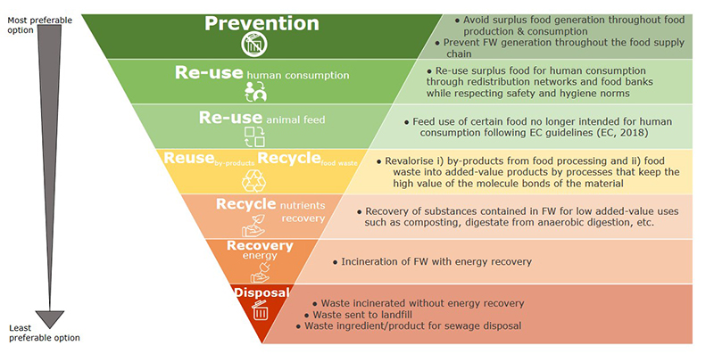
Food waste hierarchy (Moerman)
Step 1:
Define goals
Step 2:
Make the goal(s) SMART
Step 3:
Type of information needed
Step 4:
Select quantification method
Step 5:
Upscaling considerations
Food Loss
Background:
Reference list
E
A
B

Slide 46
Step 3: What Type of information needed?
Step 1:
Define goals
Step 2:
Make the goal(s) SMART
Step 3:
Type of information needed
  To quantify food loss, data need to be collected. The type of required data depends on the indicator(s) and the selected definition of FL.
  In practice, some of the data are available already (in company information system or public data), and some need effort to quantify.
  The next slide provides examples of the most common types of data applied in FL quantification
Step 4:
Select quantification method
Step 5:
Upscaling considerations
Background:
Reference list
A
B

Slide 47
Most common types of required data
Step 1:
Define goals
Step 2:
Make the goal(s) SMART
Step 3:
Type of information needed
  Weight of the food loss (sometimes conversion factor is required from value)
  Value of the food loss (you need price at the moment of discard*)
  Value loss in sales (sold at lower price; what is the price decrease)
  Production data (in tons and currency)
  Sales data (in tons and currency)
  Destination(s) of ‘food loss’ (ladder van Moerman)
  Population size
Step 4:
Select quantification method
Step 5:
Upscaling considerations
Background:
Reference list
A
*Note that same stakeholders take sales price and other cost price at that moment
B

Slide 48
Type of information you need
Step 1:
Define goals
Step 2:
Make the goal(s) SMART
Step 3:
Type of information needed
Indicator
Type of information you need | Availability
1. …
… … | … …
2. …
… … | … …
Step 4:
Select quantification method
Step 5:
Upscaling considerations
Availability options
Quantification required
Available within company
Partly available in company
Public data
Other, …
Background:
Reference list
E
A
B

Slide 49
Step 4: Select quantification method
Step 1:
Define goals
Step 2:
Make the goal(s) SMART
Step 3:
Type of information needed
This is a complex step. There are many methodologies, and the choice can be made by the user only. The document will guide you through the selection process, based on decision factors that are common in the FLW quantification context.
Step 4:
Select quantification method
Step 5:
Upscaling considerations
Background:
Reference list
A
B

Slide 50
Approach for method selection
Step 1:
Define goals
a) Process scheme
b) What process to quantify?
c) Considerations method selection
d) List of methodologies
e) Actual method selection
f) Examples
Step 2:
Make the goal(s) SMART
Step 3:
Type of information needed
Start:
Goal is SMART (product-region-time-SCL-definition) (step 2)
Step 4:
Select quantification method
Step 5:
Upscaling considerations
a) Provide process scheme within SCL for ‘START’ case
(you determine level of detail)
b) What process you want to quantify FL for*?
c) Select quantification method per process
Background:
Reference list
(see next slide)
A
* In case FL is expected to be negligible in a certain process, that process can be excluded
from the FL quantification (in house experts can be consulted to decide upon this)
B

Slide 51
Approach for method selection
Step 1:
Define goals
a) Process scheme
b) What process to quantify?
c) Considerations method selection
d) List of methodologies
e) Actual method selection
f) Examples
Step 2:
Make the goal(s) SMART
Step 3:
Type of information needed
Step 4:
Select quantification method
d) List of quantification methods, including characteristics
Step 5:
Upscaling considerations
e1) practical match*
e2) user preferences
method
Background:
Reference list
A
* In FLW quantification, research is done about what method usually is applied for what SCL,
based on practicalities
B

Slide 52
a) Provide process scheme within SCL
Step 1:
Define goals
a) Process scheme
b) What process to quantify?
c) Considerations method selection
d) List of methodologies
e) Actual method selection
f) Examples
Step 2:
Make the goal(s) SMART
Step 3:
Type of information needed
Process 1
Process 2
…
Process 6
Step 4:
Select quantification method
residue
residue
residue
Step 5:
Upscaling considerations
Food loss? (depending on destination)
Example wholesaler
Input quality control
Processing
Storage
Sales distribution
rejection
cut losses
expiry date
damaged product
Return to supplier
Farmer (animal feed)
Digester
Digester
Background:
Reference list
No food loss
No food loss
Food loss
Food loss
A
B

Slide 53
b) What process you want to quantify for?
Step 1:
Define goals
a) Process scheme
b) What process to quantify?
c) Considerations method selection
d) List of methodologies
e) Actual method selection
f) Examples
Step 2:
Make the goal(s) SMART
Step 3:
Type of information needed
Process 1
Process 2
…
Process 6
Step 4:
Select quantification method
residue
residue
residue
Step 5:
Upscaling considerations
Food loss? (depending on destination)
Example wholesaler
Input quality control
Processing
Storage
Sales distribution
rejection
cut losses
expiry date
damaged product
Return to supplier
Farmer (animal feed)
Digester
Digester
Background:
Reference list
No food loss
No food loss
Food loss
Food loss
A
B

Slide 54
c) Considerations method selection per process
Step 1:
Define goals
a) Process scheme
b) What process to quantify?
c) Considerations method selection
d) List of methodologies
e) Actual method selection
f) Examples
Step 2:
Make the goal(s) SMART
Step 3:
Type of information needed
Again, choices must be made. Now the required data are described, it is time to select a method. Each of the methodologies has its own characteristics (pros and cons), and the ‘best’ choice is always user-driven, depending on his/her requirements (e.g., time, accuracy). This document supports the decision making with respect to the methodology and beyond, by zooming in how the methodology can be applied per selected process within the SCL.
Examples are presented per method.
Step 4:
Select quantification method
Step 5:
Upscaling considerations
Background:
Reference list
A
B

Slide 55
d) List of quantification methods
Step 1:
Define goals
a) Process scheme
b) What process to quantify?
c) Considerations method selection
d) List of methodologies
e) Actual method selection
f) Examples
Step 2:
Make the goal(s) SMART
Step 3:
Type of information needed
Step 4:
Select quantification method
Assessing volume
Modeling
Step 5:
Upscaling considerations
Counting
Proxy data
Diaries
Records
Direct weighing
Secondary data/literature
Expert opinion
Surveys/interviews
Mass balance
Waste composition analysis
Background:
Reference list
A
B

Slide 56
Method description: Assessing volume
Step 1:
Define goals
Methodologies overview
Method description
Method Characteristics
Remarks
Step 2:
Make the goal(s) SMART
Step 3:
Type of information needed
Assessing the physical space occupied by FLW, and using the result to determine the weight
Example:
household keep track of how many portions they throw away (1 portion is defined as a handful), and later (based on sampling) the conversion to weight is made. This avoids the laborious effort of weighing.
Step 4:
Select quantification method
Step 5:
Upscaling considerations
Background:
Reference list
A
B

Slide 57
Method characteristics: Assessing volume
Step 1:
Define goals
Methodologies overview
Method description
Method Characteristics
Remarks
Step 2:
Make the goal(s) SMART
Step 3:
Type of information needed
Characteristics | Answer
Direct access to FLW needed? | Yes
Level of accuracy? | Low-medium
Track causes? | No
Required resources | Medium
Handle mixed FLW? | No
Records FLW available? | No
Is much of the FLW prepacked? | Don’t know
Are inputs and outputs recorded that could be used for inferring the amount of FLW? | No
Step 4:
Select quantification method
Step 5:
Upscaling considerations
Background:
Reference list
A
B

Slide 58
Remarks: Assessing volume
Step 1:
Define goals
Methodologies overview
Method description
Method Characteristics
Remarks
Step 2:
Make the goal(s) SMART
Step 3:
Type of information needed
  Is always part of another quantification method (e.g. diary)
  Relatively little effort (participation easier)
  Additional sampling is required for conversion to weight
  In most cases difficult to use. Examples are rare: household diaries writing down portions of a certain product, or a restaurant operator estimating how full a garbage container is
Step 4:
Select quantification method
Step 5:
Upscaling considerations
Background:
Reference list
E
A
B

Slide 59
Method description: Counting
Step 1:
Define goals
Methodologies overview
Method description
Method Characteristics
Remarks
Step 2:
Make the goal(s) SMART
Step 3:
Type of information needed
Assessing the number of items that make up FLW and using the result to determine the weight; includes using scanner data and “visual scales”
Example:
Counting packed food products and calculate FL by multiplication with weight per piece. This avoids the laborious effort of weighing.
Step 4:
Select quantification method
Step 5:
Upscaling considerations
Background:
Reference list
A
B

Slide 60
Method characteristics: Counting
Step 1:
Define goals
Methodologies overview
Method description
Method Characteristics
Remarks
Step 2:
Make the goal(s) SMART
Step 3:
Type of information needed
Characteristics | Answer
Direct access to FLW needed? | Yes
Level of accuracy? | Medium-High
Track causes? | No
Required resources | Medium
Handle mixed FLW? | No
Records FLW available? | No
Are inputs and outputs recorded that could be used for inferring the amount of FLW? | No
Step 4:
Select quantification method
Step 5:
Upscaling considerations
Background:
Reference list
A
B

Slide 61
Remarks: Counting
Step 1:
Define goals
Methodologies overview
Method description
Method Characteristics
Remarks
Step 2:
Make the goal(s) SMART
Step 3:
Type of information needed
  Relatively little effort (participation easier)
  Calculation (evt. additional sampling) is required for conversion to weight)
  Mainly used for (pre)packed products (e.g. bags, expiry date products)
  In most cases recruitment of participants required
Step 4:
Select quantification method
Step 5:
Upscaling considerations
Background:
Reference list
E
A
B

Slide 62
Method description: Diaries
Step 1:
Define goals
Methodologies overview
Method description
Method Characteristics
Remarks
Step 2:
Make the goal(s) SMART
Step 3:
Type of information needed
Maintaining a daily log of FLW and other information (paper-based or electronically)
Example:
typically used in households: The diary usually calls for the participant to log the amount and type of food being lost or wasted, along with how and why the FLW was discarded.
Step 4:
Select quantification method
Step 5:
Upscaling considerations
Background:
Reference list
A
B

Slide 63
Method characteristics: Diaries
Step 1:
Define goals
Methodologies overview
Method description
Method Characteristics
Remarks
Step 2:
Make the goal(s) SMART
Step 3:
Type of information needed
Characteristics | Answer
Direct access to FLW needed? | Yes*
Level of accuracy? | Low-Medium
Track causes? | Yes
Required resources | Medium
Handle mixed FLW? | No
Records FLW available? | No
Are inputs and outputs recorded that could be used for inferring the amount of FLW? | No
Step 4:
Select quantification method
Step 5:
Upscaling considerations
Background:
Reference list
A
* CEC-report claims no
B

Slide 64
Remarks: Diaries
Step 1:
Define goals
Methodologies overview
Method description
Method Characteristics
Remarks
Step 2:
Make the goal(s) SMART
Step 3:
Type of information needed
  Recruitment participants required
  Preparation of material requires significant effort
  Level of expertise required for setting it up
  Qualitative information can be collected as well (e.g. causes, purchasing and storage behaviour)
Step 4:
Select quantification method
Step 5:
Upscaling considerations
Background:
Reference list
E
A
B

Slide 65
Method description: Direct weighing
Step 1:
Define goals
Methodologies overview
Method description
Method Characteristics
Remarks
Step 2:
Make the goal(s) SMART
Step 3:
Type of information needed
Using a measuring device to determine the weight of FLW
Example:
hospitals running a kitchen, have leftovers when portioning. These waste flows can be weighed per component in the kitchen.
Step 4:
Select quantification method
Step 5:
Upscaling considerations
Background:
Reference list
A
B

Slide 66
Method characteristics: Direct weighing
Step 1:
Define goals
Methodologies overview
Method description
Method Characteristics
Remarks
Step 2:
Make the goal(s) SMART
Step 3:
Type of information needed
Characteristics | Answer
Direct access to FLW needed? | Yes
Level of accuracy? | High
Track causes? | Yes
Required resources | High
Handle mixed FLW? | No (only if product list contains mixed products)
Records FLW available? | No
Are inputs and outputs recorded that could be used for inferring the amount of FLW? | No
Step 4:
Select quantification method
Step 5:
Upscaling considerations
Background:
Reference list
A
B

Slide 67
Remarks: Direct weighing
Step 1:
Define goals
Methodologies overview
Method description
Method Characteristics
Remarks
Step 2:
Make the goal(s) SMART
Step 3:
Type of information needed
  Level of expertise required for setting it up
  Qualitative information can be collected as well
  (causes, which moment/meal of the day, …)
  Reference value required by independent person
  (behaviour changes when observed/measured)
Step 4:
Select quantification method
Step 5:
Upscaling considerations
Background:
Reference list
E
A
B

Slide 68
Method description: Expert opinion
Step 1:
Define goals
Methodologies overview
Method description
Method Characteristics
Remarks
Step 2:
Make the goal(s) SMART
Step 3:
Type of information needed
Asking 2 or 3 experts (from the sector and science; maybe some FLW measurement expertise or small tests with FLW is available) and let them estimate the FLW at the focus point (mostly provided as a %)
Example:
in storage of agricultural products, farmers have an idea how much % is FL. Scientist have an independent view and may have access to reference values from literature or experiments
Step 4:
Select quantification method
Step 5:
Upscaling considerations
Background:
Reference list
A
B

Slide 69
Method characteristics: Expert opinion
Step 1:
Define goals
Methodologies overview
Method description
Method Characteristics
Remarks
Step 2:
Make the goal(s) SMART
Step 3:
Type of information needed
Characteristics | Answer
Direct access to FLW needed? | No
Level of accuracy? | Medium
Track causes? | Yes
Required resources | Low-Medium
Handle mixed FLW? | No
Records FLW available? | No
Are inputs and outputs recorded that could be used for inferring the amount of FLW? | No
Step 4:
Select quantification method
Step 5:
Upscaling considerations
Background:
Reference list
A
B

Slide 70
Remarks: Expert opinion
Step 1:
Define goals
Methodologies overview
Method description
Method Characteristics
Remarks
Step 2:
Make the goal(s) SMART
Step 3:
Type of information needed
  Quality of output very much depends on experts you can ask
  (e.g. years of experience)
  Qualitative input can be acquired
  (e.g. causes, trends, technologies to avoid FLW)
  Experts often know where the focus of the FLW is in a certain SCL
  (e.g. French Fries processor at peeling). This could help to reduce the quantification effort.
Step 4:
Select quantification method
Step 5:
Upscaling considerations
Background:
Reference list
E
A
B

Slide 71
Method description: Mass balance
Step 1:
Define goals
Methodologies overview
Method description
Method Characteristics
Remarks
Step 2:
Make the goal(s) SMART
Step 3:
Type of information needed
Measuring inputs (e.g., ingredients at a factory site, grain going into a silo) and outputs (e.g., products made, grain shipped to market) alongside changes in levels of stock and changes to the weight of food during processing
Example:
country level: production – change in stock + imports – export – consumption= FLW. FAO used this approach for many years.
Step 4:
Select quantification method
Step 5:
Upscaling considerations
Background:
Reference list
A
B

Slide 72
Method characteristics: Mass balance
Step 1:
Define goals
Methodologies overview
Method description
Method Characteristics
Remarks
Step 2:
Make the goal(s) SMART
Step 3:
Type of information needed
Characteristics | Answer
Direct access to FLW needed? | No
Level of accuracy? | Low-Medium
Track causes? | No
Required resources | Medium
Handle mixed FLW? | No
Records FLW available? | Yes
Are inputs and outputs recorded that could be used for inferring the amount of FLW? | Yes
Step 4:
Select quantification method
Step 5:
Upscaling considerations
Background:
Reference list
A
B

Slide 73
Remarks: Mass balance
Step 1:
Define goals
Methodologies overview
Method description
Method Characteristics
Remarks
Step 2:
Make the goal(s) SMART
Step 3:
Type of information needed
  Required information is available in most cases
  The higher the number of sources, the required level of expertise as well as the cost may be high (because of e.g. data conversion, different categorizations, etc.)
Step 4:
Select quantification method
Step 5:
Upscaling considerations
Background:
Reference list
E
A
B

Slide 74
Method description: Modeling
Step 1:
Define goals
Methodologies overview
Method description
Method Characteristics
Remarks
Step 2:
Make the goal(s) SMART
Step 3:
Type of information needed
Using a mathematical approach based on the interaction of multiple factors
that influence the generation of FLW
Example:
farmer characteristics and causes can be used as inputs for a model with output
the FLW. Examples of identified inputs are: experience, educational level, use of fertilizer.
Step 4:
Select quantification method
Step 5:
Upscaling considerations
Background:
Reference list
A
B

Slide 75
Method characteristics: Modeling
Step 1:
Define goals
Methodologies overview
Method description
Method Characteristics
Remarks
Step 2:
Make the goal(s) SMART
Step 3:
Type of information needed
Characteristics | Answer
Direct access to FLW needed? | No
Level of accuracy? | Low-Medium
Track causes? | Yes
Required resources | High
Handle mixed FLW? | No
Records FLW available? | No
Are inputs and outputs recorded that could be used for inferring the amount of FLW? | No
Step 4:
Select quantification method
Step 5:
Upscaling considerations
Background:
Reference list
A
B

Slide 76
Remarks: Modeling
Step 1:
Define goals
Methodologies overview
Method description
Method Characteristics
Remarks
Step 2:
Make the goal(s) SMART
Step 3:
Type of information needed
  Modeling requires lots of input and output data
  Experience with statistics in modeling techniques is necessary
  Until now, no promising results are derived
  Lot of work is done on cause analysis
Step 4:
Select quantification method
Step 5:
Upscaling considerations
Background:
Reference list
E
A
B

Slide 77
Method description: Proxy data
Step 1:
Define goals
Methodologies overview
Method description
Method Characteristics
Remarks
Step 2:
Make the goal(s) SMART
Step 3:
Type of information needed
Using FLW data that are outside the scope of an entity’s FLW inventory (e.g., older data, FLW data from another country or company) to infer quantities of FLW within the scope of the entity’s inventory
Example:
FL data for a certain crop in one country, may be similar in a neighboring country if climatic and development conditions are similar.
Step 4:
Select quantification method
Step 5:
Upscaling considerations
Background:
Reference list
A
B

Slide 78
Method characteristics: Proxy data
Step 1:
Define goals
Methodologies overview
Method description
Method Characteristics
Remarks
Step 2:
Make the goal(s) SMART
Step 3:
Type of information needed
Characteristics | Answer
Direct access to FLW needed? | No
Level of accuracy? | Low-Medium
Track causes? | No
Required resources | Low
Handle mixed FLW? | No
Records FLW available? | Yes (on proxy data)
Are inputs and outputs recorded that could be used for inferring the amount of FLW? | Yes
Step 4:
Select quantification method
Step 5:
Upscaling considerations
Background:
Reference list
A
B

Slide 79
Remarks: Proxy data
Step 1:
Define goals
Methodologies overview
Method description
Method Characteristics
Remarks
Step 2:
Make the goal(s) SMART
Step 3:
Type of information needed
  Quality of result of quantification very much depends on quality of proxy data (completeness, comparable units, …) and representativeness of proxy for actual FLW
  Understanding the focus point (product-scl) is necessary to apply this approach by determining the appropriate proxies
Step 4:
Select quantification method
Step 5:
Upscaling considerations
Background:
Reference list
E
A
B

Slide 80
Method description: Records
Step 1:
Define goals
Methodologies overview
Method description
Method Characteristics
Remarks
Step 2:
Make the goal(s) SMART
Step 3:
Type of information needed
Using individual pieces of data that have been written down or saved, and that are often routinely collected for reasons other than quantifying FLW (e.g., waste transfer receipts or warehouse record books)
Example:
in retail, everything is automatically saved in computer systems: sales, purchases, waste (often with cause). Also stock-keeping tools at wholesale can be used.
Step 4:
Select quantification method
Step 5:
Upscaling considerations
Background:
Reference list
A
B

Slide 81
Method characteristics: Records
Step 1:
Define goals
Methodologies overview
Method description
Method Characteristics
Remarks
Step 2:
Make the goal(s) SMART
Step 3:
Type of information needed
Characteristics | Answer
Direct access to FLW needed? | No
Level of accuracy? | High
Track causes? | Depends
Required resources | Low, if records already provide the required info
Handle mixed FLW? | No
Records FLW available? | Yes
Are inputs and outputs recorded that could be used for inferring the amount of FLW? | Yes
Step 4:
Select quantification method
Step 5:
Upscaling considerations
Background:
Reference list
A
B

Slide 82
Remarks: Records
Step 1:
Define goals
Methodologies overview
Method description
Method Characteristics
Remarks
Step 2:
Make the goal(s) SMART
Step 3:
Type of information needed
  Records are most likely to be useful in the manufacturing, retail and food service sectors, since proprietors frequently collect and track data relating to purchasing, food inventory and waste management (including donation receipts).
  To obtain insight in the accuracy, it is necessary to find out how the data in the records are collected
Step 4:
Select quantification method
Step 5:
Upscaling considerations
Background:
Reference list
E
A
B

Slide 83
Method description: Secondary data/literature
Step 1:
Define goals
Methodologies overview
Method description
Method Characteristics
Remarks
Step 2:
Make the goal(s) SMART
Step 3:
Type of information needed
This method uses data that is collected earlier by someone else.
Example:
in secondary data/literature lots of direct measurements are carried out on FLW.
If the focus is similar, these data are often used as estimate for the FLW in their
own situation.
Step 4:
Select quantification method
Step 5:
Upscaling considerations
Background:
Reference list
A
B

Slide 84
Method characteristics: Secondary data/literature
Step 1:
Define goals
Methodologies overview
Method description
Method Characteristics
Remarks
Step 2:
Make the goal(s) SMART
Step 3:
Type of information needed
Characteristics | Answer
Direct access to FLW needed? | No
Level of accuracy? | Low
Track causes? | Depends
Required resources | Low
Handle mixed FLW? | Possible
Records FLW available? | No
Are inputs and outputs recorded that could be used for inferring the amount of FLW? | No
Step 4:
Select quantification method
Step 5:
Upscaling considerations
Background:
Reference list
A
B

Slide 85
Remarks: Secondary data/literature
Step 1:
Define goals
Methodologies overview
Method description
Method Characteristics
Remarks
Step 2:
Make the goal(s) SMART
Step 3:
Type of information needed
  You need access to (scientific) literature
  Therefore, some level of experience in FLW terminology (and its complexity)
  is required
  Take a close look at the reference if conditions and timing (year; not 1996)
  of research are close to the situation you want to quantify FL for
Step 4:
Select quantification method
Step 5:
Upscaling considerations
Background:
Reference list
E
A
B

Slide 86
Method description: Surveys/interviews
Step 1:
Define goals
Methodologies overview
Method description
Method Characteristics
Remarks
Step 2:
Make the goal(s) SMART
Step 3:
Type of information needed
Gathering data on FLW quantities or other information (e.g., attitudes, beliefs, self-reported behaviors) from a large number of individuals or entities through a set of structured questions
Example:
a quantitative survey is carried out with VAVI (potato processors).
Every year a standardized quantitative questionnaire is sent to the companies.
Step 4:
Select quantification method
Step 5:
Upscaling considerations
Background:
Reference list
A
B

Slide 87
Method characteristics: Surveys/interviews
Step 1:
Define goals
Methodologies overview
Method description
Method Characteristics
Remarks
Step 2:
Make the goal(s) SMART
Step 3:
Type of information needed
Characteristics | Answer
Direct access to FLW needed? | No
Level of accuracy? | Low-Medium
Track causes? | Yes
Required resources | Medium-High
Handle mixed FLW? | No
Records FLW available? | Depends
Are inputs and outputs recorded that could be used for inferring the amount of FLW? | Depends
Step 4:
Select quantification method
Step 5:
Upscaling considerations
Background:
Reference list
A
B

Slide 88
Remarks: Surveys/interviews
Step 1:
Define goals
Methodologies overview
Method description
Method Characteristics
Remarks
Step 2:
Make the goal(s) SMART
Step 3:
Type of information needed
  Surveys are a cost-effective way of gathering information from many individuals or entities on attitudes, beliefs and self-reported behaviors (consumers, restaurants, farmers).
  Can gather data on otherwise difficult-to-measure material flows
  Typically, surveys show underestimated figures of FLW
Step 4:
Select quantification method
Step 5:
Upscaling considerations
Background:
Reference list
E
A
B

Slide 89
Method description: Waste composition analysis
Step 1:
Define goals
Methodologies overview
Method description
Method Characteristics
Remarks
Step 2:
Make the goal(s) SMART
Step 3:
Type of information needed
Waste composition analysis is a process of physically separating, weighing and categorizing waste. It can be used both to determine total amounts of FLW and to categorize the different types of foods that have been discarded (e.g., fruits, vegetables, meat), or distinguish between food and inedible parts.
Example:
typically used for household FLW analysis, to see what categories and/or products are wasted the most by consumers. Campaigns can be started based on these results.
Step 4:
Select quantification method
Step 5:
Upscaling considerations
Background:
Reference list
A
B

Slide 90
Method characteristics: Waste composition analysis
Step 1:
Define goals
Methodologies overview
Method description
Method Characteristics
Remarks
Step 2:
Make the goal(s) SMART
Step 3:
Type of information needed
Characteristics | Answer
Direct access to FLW needed? | Yes
Level of accuracy? | High
Track causes? | No
Required resources | High
Handle mixed FLW? | Yes
Records FLW available? | No
Are inputs and outputs recorded that could be used for inferring the amount of FLW? | No
Step 4:
Select quantification method
Step 5:
Upscaling considerations
Background:
Reference list
A
B

Slide 91
Remarks: Waste composition analysis
Step 1:
Define goals
Methodologies overview
Method description
Method Characteristics
Remarks
Step 2:
Make the goal(s) SMART
Step 3:
Type of information needed
  The level of detail gives the opportunity to derive data on other environmental indicators like GHG-emission
  In fact, in case of mixed FLW, it is the only reliable way to collect FLW data
  on a deeper level than ‘food total’ or ‘organic total’
  There are technological devices that support this kind of FLW analysis
  (e.g. Leanpath)
Step 4:
Select quantification method
Step 5:
Upscaling considerations
Background:
Reference list
E
A
B

Slide 92
e) The method selection can be based on three elements:
Step 1:
Define goals
a) Process scheme
b) What process to quantify?
c) Considerations method selection
d) List of methodologies
e) Actual method selection
f) Examples
Step 2:
Make the goal(s) SMART
Step 3:
Type of information needed
Step 4:
Select quantification method
  Considering all methods on pros and cons (see previous slides)
  Using the practical preferences per SCL as provided from
  Literature and practice
  Using the upgraded WRI decision tool for method selection in
  Relation to your own situation
Step 5:
Upscaling considerations
Background:
Reference list
E
A
B

Slide 93
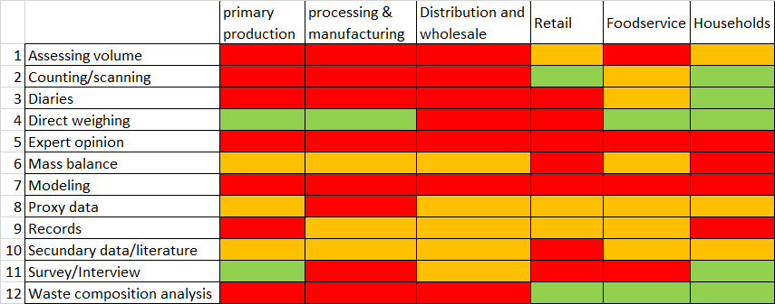
e) Which method is suitable/used for what? (see )
Step 1:
Define goals
a) Process scheme
b) What process to quantify?
c) Considerations method selection
d) List of methodologies
e) Actual method selection
f) Examples
Step 2:
Make the goal(s) SMART
e1
Step 3:
Type of information needed
Step 4:
Select quantification method
Step 5:
Upscaling considerations
Based on reference 1) and 2)
R
Background:
Reference list
rarely applied/less suitable
applied regularly/suitable
often applied/well-suited
A
B

Slide 94
e) Which method matches user preferences? (see )
Step 1:
Define goals
a) Process scheme
b) What process to quantify?
c) Considerations method selection
d) List of methodologies
e) Actual method selection
f) Examples
Step 2:
Make the goal(s) SMART
e2
Step 3:
Type of information needed
By clicking the icon, a tool, developed by WRI ( a little adjusted by WFBR) provides an option to determine the best suitable methodology according to some user preferences
Decide on what criteria are relevant for you as a user and either check on all the methodologies or click on the Methodology evaluation tool
Step 4:
Select quantification method
Step 5:
Upscaling considerations
Background:
Reference list
A
B

Slide 95
f) Examples Fruits and vegetables
Step 1:
Define goals
a) Process scheme
b) What process to quantify?
c) Considerations method selection
d) List of methodologies
e) Actual method selection
f) Examples
Step 2:
Make the goal(s) SMART
Step 3:
Type of information needed
SC link | Direct weighing | Survey | Expert | Literature
Farmer
Exporter
Wholesaler
Step 4:
Select quantification method
Step 5:
Upscaling considerations
Background:
Reference list
A
B

Slide 96
Step 5: Upscaling considerations
Step 1:
Define goals
Step 2:
Make the goal(s) SMART
Step 3:
Type of information needed
Once the data are collected, some additional steps are required to finalize the result. This depends very much on the focus. One of the issues is if upscaling is required:
Step 4:
Select quantification method
Step 5:
Upscaling considerations
Quantification
Upscaling required
No upscaling required
In time
Locations
Background:
Reference list
A
B

Slide 97
Step 5: Upscaling considerations
Step 1:
Define goals
Step 2:
Make the goal(s) SMART
Step 3:
Type of information needed
No upscaling required:
E.g., when analysis is limited to one company or very small supply chain, and quantification takes place continuously (supermarket)
Outliers:
these are defined as data point outside the interval (μ-3σ, μ+3σ) (μ=mean, σ=stdev). Are they caused by e.g., promotions (then FL data should be included, i.e. regular predictable activities) or by incidents (excluded)?
Step 4:
Select quantification method
Step 5:
Upscaling considerations
Background:
Reference list
A
B

Slide 98
Step 5: Upscaling considerations
Step 1:
Define goals
Step 2:
Make the goal(s) SMART
Step 3:
Type of information needed
Upscaling in time:
necessary if the quantification is limited to a small time period and the target is to estimate the FL for a longer period. E.g., can real measurements for 2 weeks be multiplied by 26 to obtain annual FL data? Is there a seasonality effect?
Upscaling number of locations:
if you interview 50 farmers out of 10,000; is that enough to reach a certain accuracy if you scale up? (https://www.calculator.net/sample-size-calculator.html )
Step 4:
Select quantification method
Step 5:
Upscaling considerations
Background:
Reference list
A
B

Slide 99
Background: Reference list
Step 1:
Define goals
Step 2:
Make the goal(s) SMART
Step 3:
Type of information needed
http://www.cec.org/files/documents/publications/11869-why-and-how-measure-food-loss-and-waste-practical-guide-version-20-en.pdf
https://hal.inrae.fr/hal-02799764v1/
Step 4:
Select quantification method
Step 5:
Upscaling considerations
Background:
Reference list
A
B

Slide 100
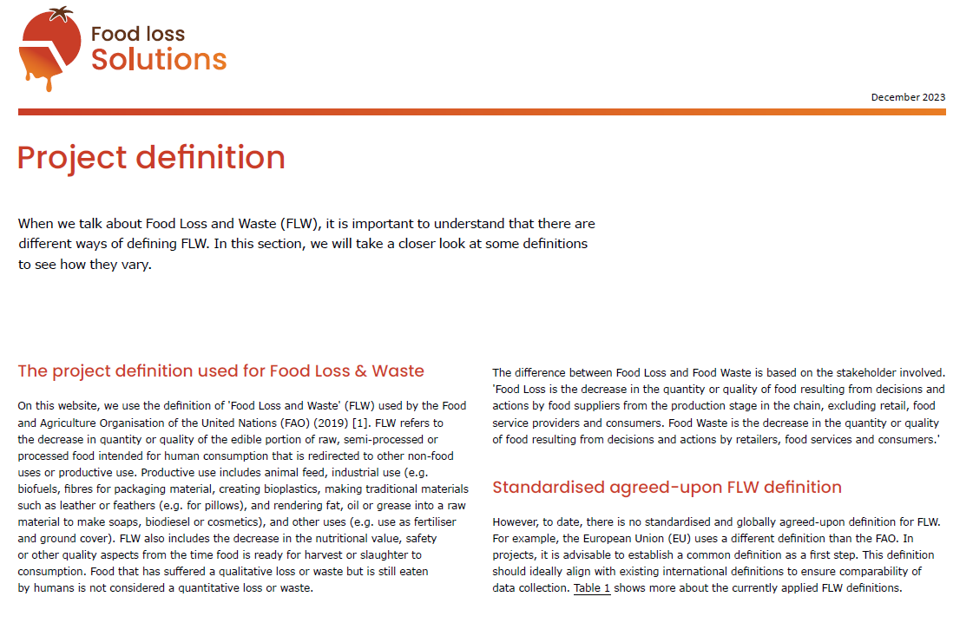
A
B

Slide 101
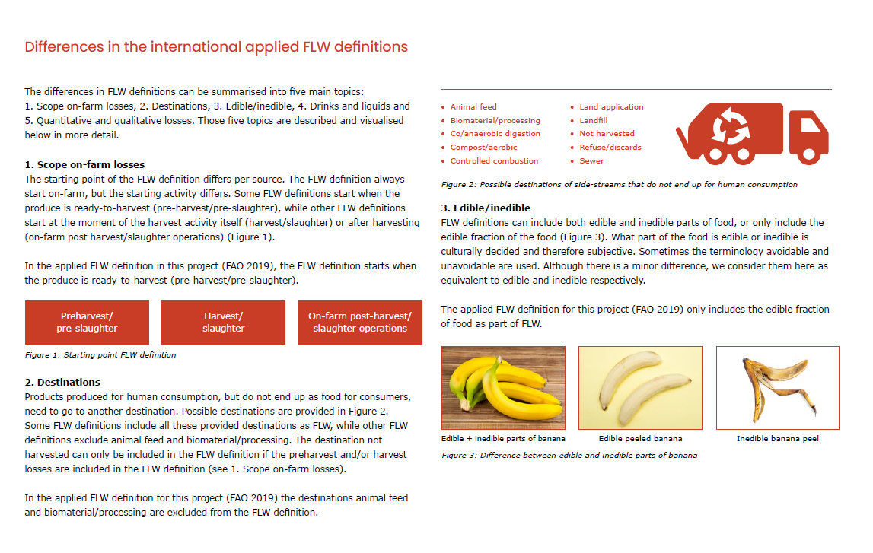
A
B

Slide 102
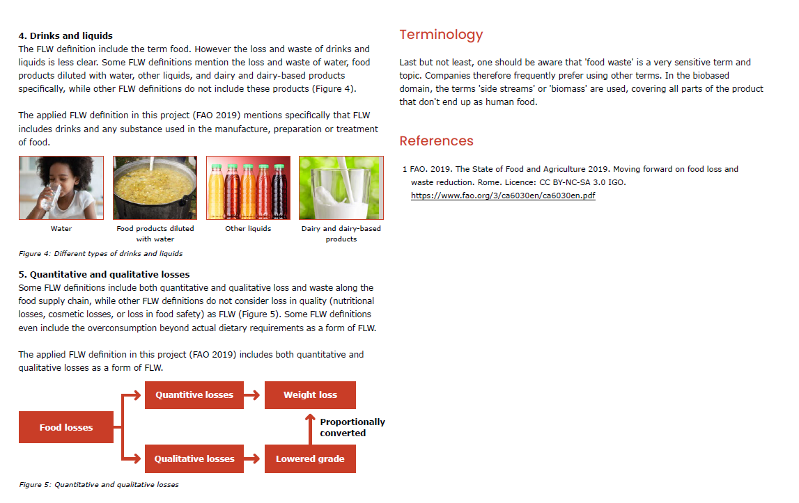
A
B

Slide 103
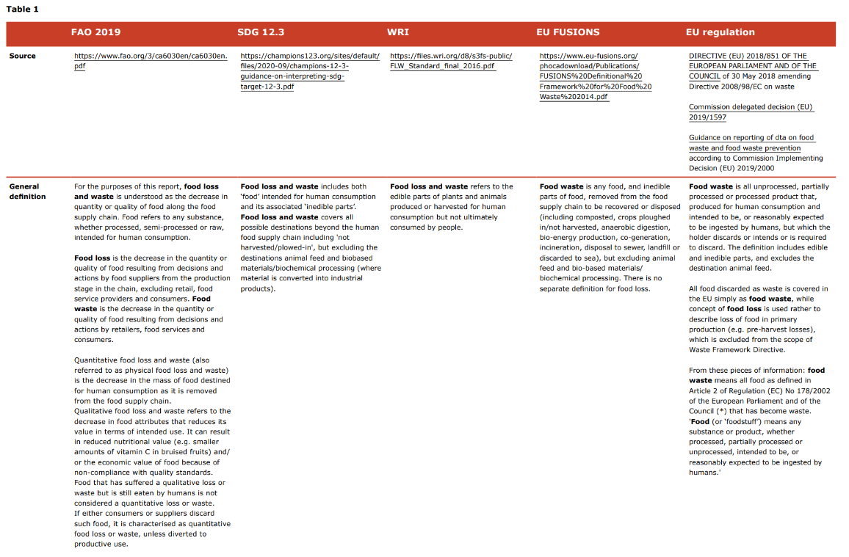
A
B

Slide 104
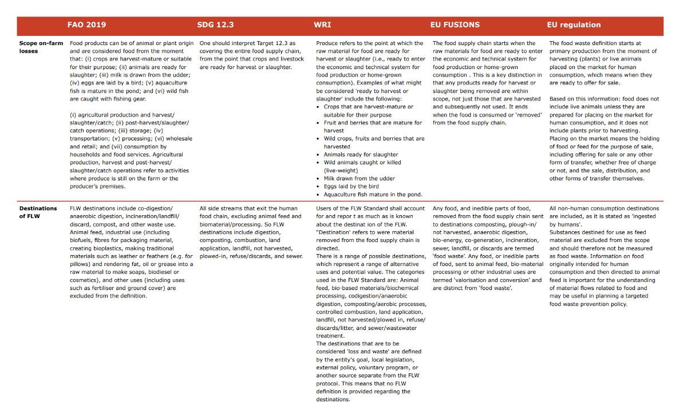
A
B

Slide 105
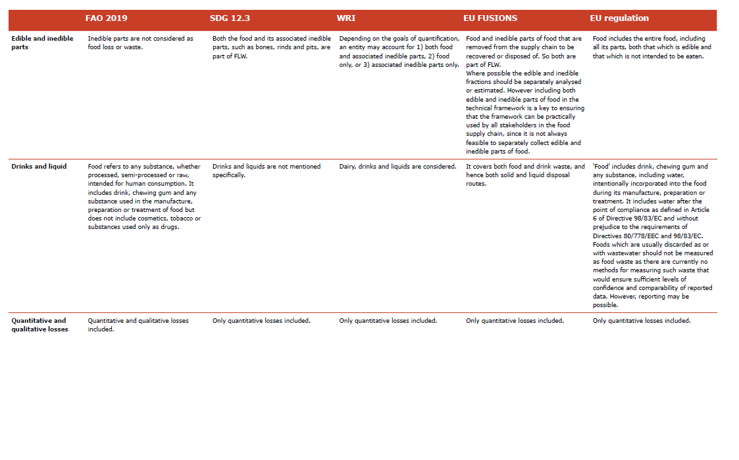
E
A
Back to sheet with link to definitions
B

Slide 106

FLW protocol overview
WUR (2022). EFFICIENT Protocol | Protocol developed to quickly gather reliable data and to suggest interventions for FLW reduction | https://www.wur.nl/en/research-results/research-institutes/food-biobased-research/show-fbr/take-the-target-measure-act-approach-to-reduce-food-waste-yes-but-be-pragmatic-about-it.htm
WRI (2016). FLW accounting and reporting standard | Most referenced FLW protocol for monitoring and reporting data | https://files.wri.org/d8/s3fs-public/FLW_Standard_final_2016.pdf
FAO (2018). Global food loss index | Calculation methodology for SDG 12.3 on food losses | https://www.fao.org/3/CA2640EN/ca2640en.pdf
UNEP (2020). Food Waste Index | Calculation methodology for SDG 12.3 on food waste | https://www.unep.org/resources/report/unep-food-waste-index-report-2021
UNEP (2014). Prevention and reduction of food and drink waste in businesses and households: Guidance for governments, local authorities, businesses and other organizations. | Steps for governments, businesses and other organisations to develop strategies, programmes and activities to prevent and reduce food and drink waste | https://wedocs.unep.org/handle/20.500.11822/25194
CEC (2019). Why and how to measure food loss and waste: A practical guide | Step-by-step plan for how companies and governments can begin the process of measuring food loss and waste | http://www.cec.org/files/documents/publications/11814-why-and-how-measure-food-loss-and-waste-practical-guide-en.pdf
IFPRI (2017). The reality of food losses: A new measurement methodology | FLW quantification protocol for producers, middlemen, and processors in seven staple food value chains in five developing countries. | https://ebrary.ifpri.org/utils/getfile/collection/p15738coll2/id/131530/filename/131741.pdf
EU Fusions (2016). FUSIONS food waste quantification manual to monitor food waste amounts and progression | European quantification manual to monitor FLW at (European) country level | https://www.eu-fusions.org/phocadownload/Publications/FUSIONS%20Food%20Waste%20Quantification%20Manual.pdf
GIZ (2015). Rapid Loss Appraisal Tool (RLAT). Assessing hot spots for food loss in agricultural value chains | Tool and methodology to gather data and suggest interventions for FLW reduction via Participatory Assessment. | https://www.giz.de/de/downloads/giz2021-0313en-rapid-loss-appraisal-tool-user-guide.pdf https://wocatpedia.net/images/5/55/GIZ_RLAT_toolbox.pdf
global food loss metric tool (in development; WWF US, WWF UK, WRI, WRAP, etc). | Develop a FL measurement- and reporting tool for farm level. | https://www.worldwildlife.org/pages/creating-a-unified-approach-to-measure-loss-on-farms-globally
A

Slide 107
Abbreviations
FL quantification
FAO: food and agricultural organization of United Nations
FLI: food loss index
FLW: food loss and waste
QU: quantification unit
ROI: return on investment
SCL: supply chain link(s)
SDG: sustainable development goals
SMART: Specific, Measurable, Achievable, Realistic, Timely
WRI: World Resources Institute
B

Slide 108

Contact us
FL quantification
THANK YOU!
Do you have questions about using this tool? We are happy to help.
Please fill out the contact form and we will get back to you soon.
Author: Han Soethoudt
Version 1, September 2024
www.foodloss-solutions.com
The FL quantification tool, developed by Wageningen University & Research, is part of the KoM project “Synthesising Food Loss Research Results into Applied Food Loss Reduction Tools”, project number BO-43-000-044, financed by the Ministry of Agriculture, Fisheries, Food Security and Nature, 2022-2024.

